Slide 1
Assignment Four; Drawing to Scale
Marissa Casamento, Stefani Costanzo, Abigail Fleming, Brittany Meurs, & Anne Martens
Department of Occupational Therapy, Nova Southeastern University
OTD 8244: Innovations and Technology in Contemporary Occupational Therapy
Dr. Yu Hsiang Liang-Paultre, OTD, OTR/L, CKTP, CSRS
June 16, 2024

Slide 2
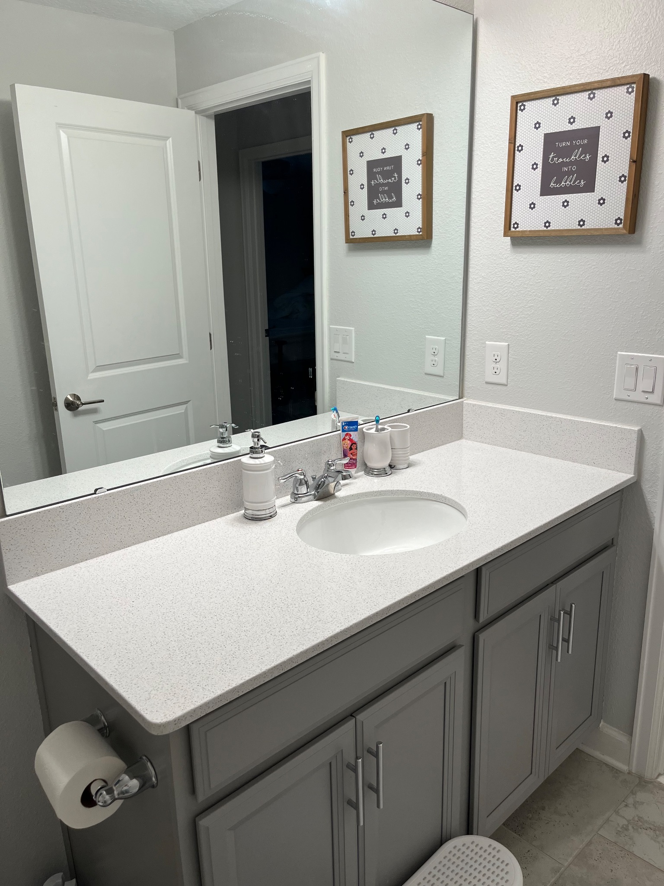
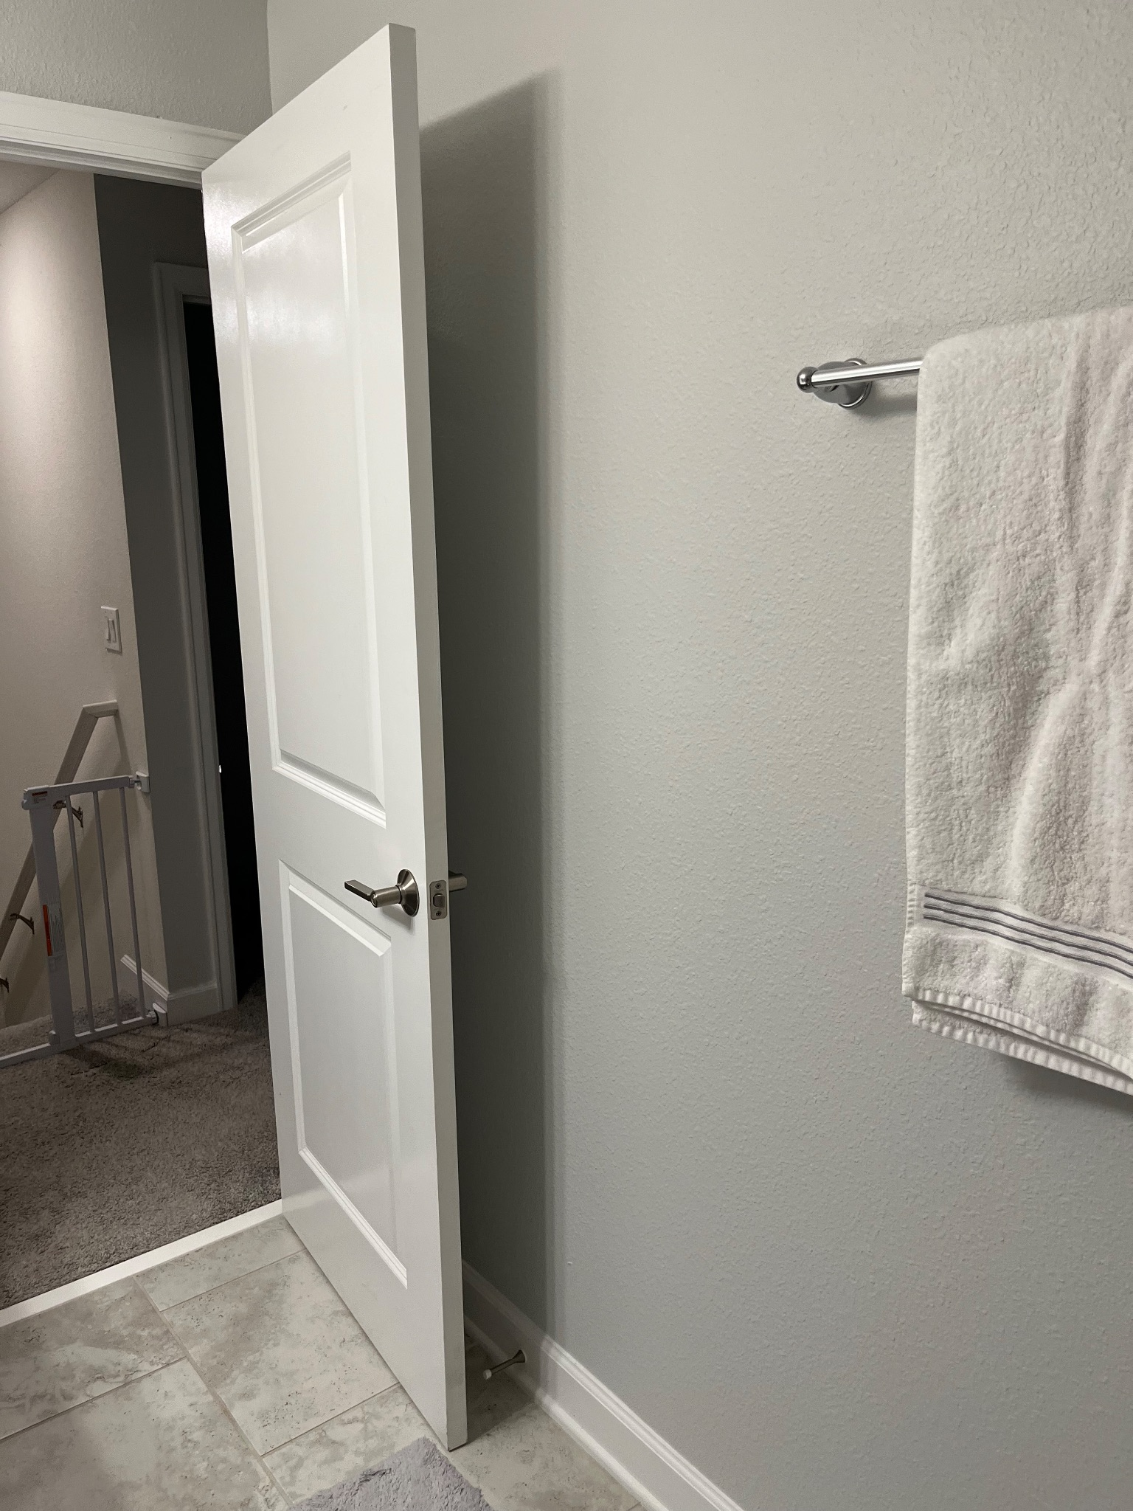
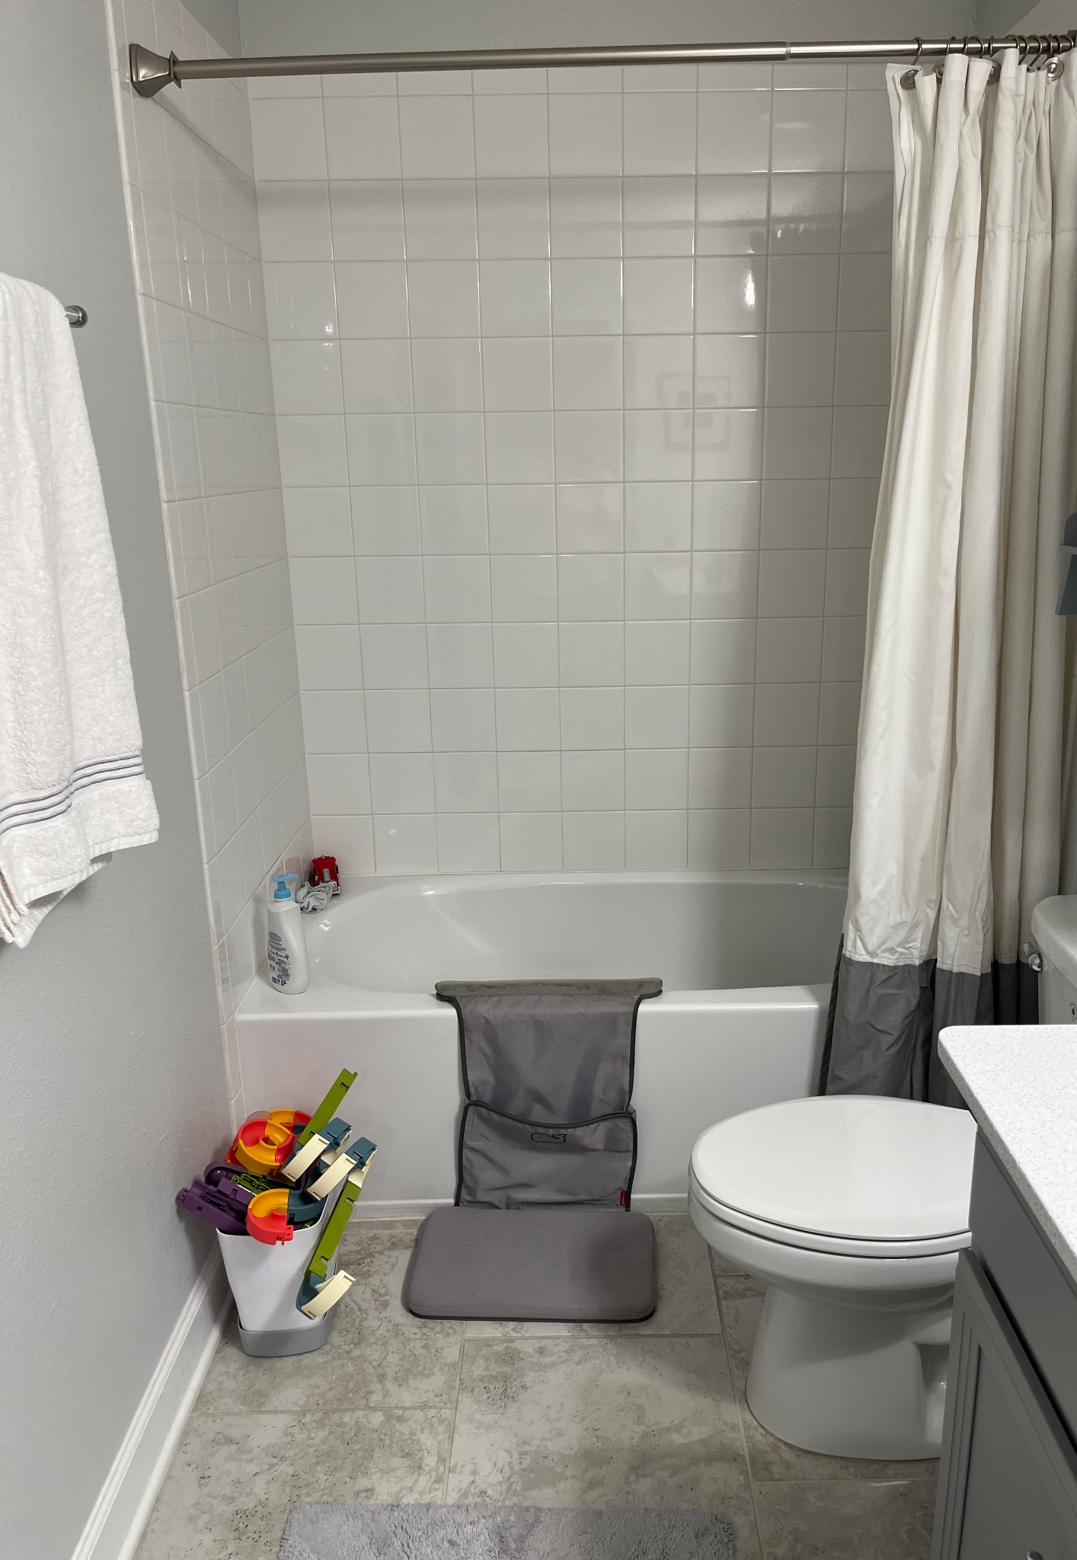
Bathroom

Slide 3
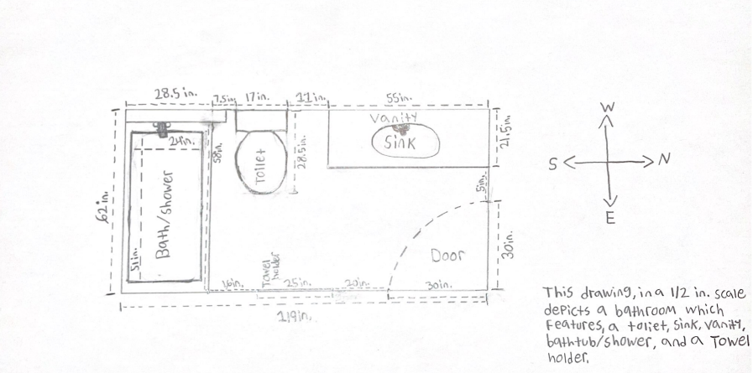
Bathroom: ½” Scale
This drawing in a ½” scale depicts a bathing which features a toilet (16.5 in. in height), sink, vanity (35.5 in. in height), bathtub/shower (17.5 in. to step into), and a towel holder. There are no windows in the room. The height from the floor to ceiling measures 93”. All measurements were taken by hand using a measuring tape.

Slide 4
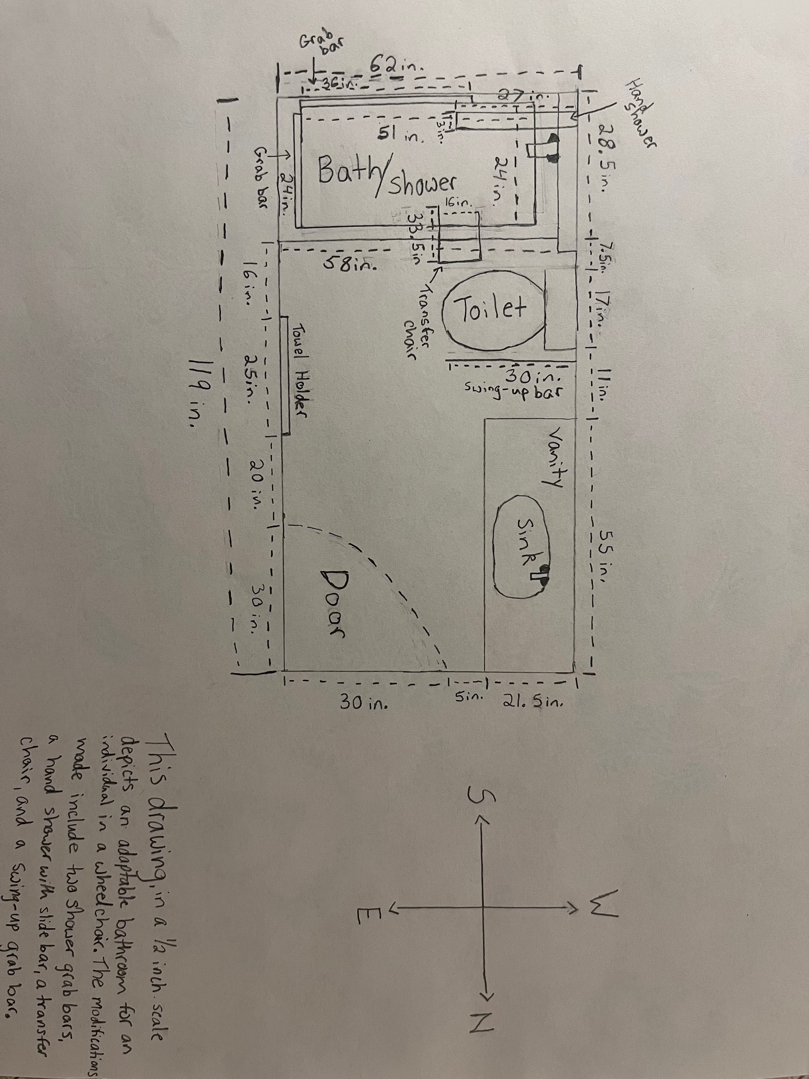
Bathroom: Modified ½” Scale
This drawing, in a ½ inch scale depicts an adaptable bathroom for a individual with a wheelchair. The modifications made include two shower grab bars, a hand shower with slide bar, a transfer chair, and a swing-up grab bar next to the toilet.
1 shower grab bar = 24 inches
1 shower grab bar = 36 inches
The hand shower with slide bar = 27 inches long & 3 inches wide
The transfer chair = 33.5 inches in length & 16 inches in width
The swing-up grab bar = 30 inches in length

Slide 5
Bathroom Modifications Overview
Transfer Bench & Shower Chair
Shower with
Slide Bar
ADA- Compliant Toilet
Add a transfer bench with a shower chair to facilitate safe access to and from the shower. Include a curtain guard to prevent water damage.
Install a toilet above the floor, in line with ADA recommendations, to ease transfer to and from the toilet.
Install a hand shower with a slide bar for adjustable shower head height and better accessibility during showering.

Slide 6
Bathroom Modifications Overview (Continued)
Toilet Swing-Up
Grab Bars
Shower Grab Bars
Sliding Shower
Head
Removal of Obstacles
A swing-up grab bar (or flip-up bar) that can pivot upward when not in use to keep the bathroom area clear. It provides support during transitions to and from the toilet.
Install grab bars for support during transfers and adjustments in the shower. Include a horizontal shower bar with shelf to ease accessibility to hygiene/shower products.
Install an adjustable shower head to facilitate access to the water facet and ease bathing.
Remove miscellaneous items to reduce fall risk and facilitate access to the shower and toilet.

Slide 7
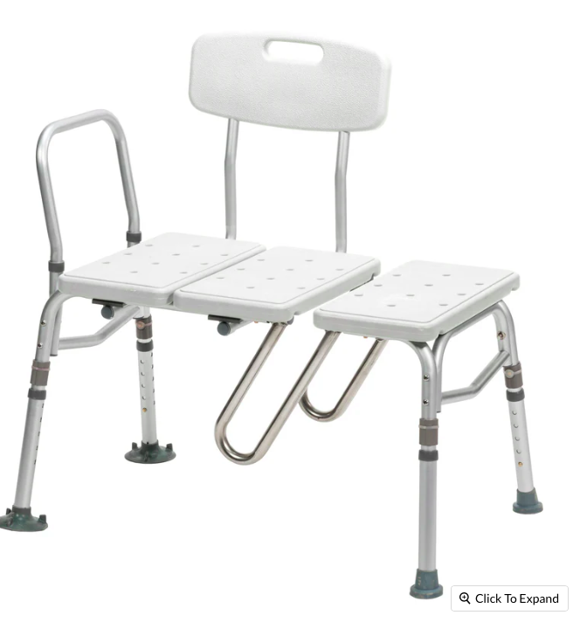
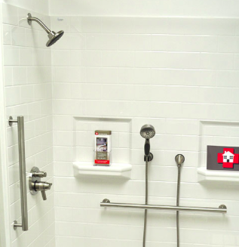
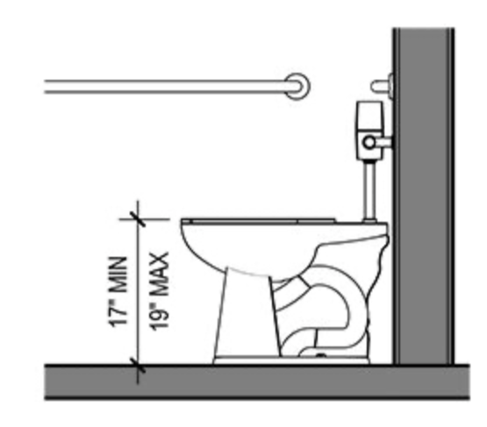
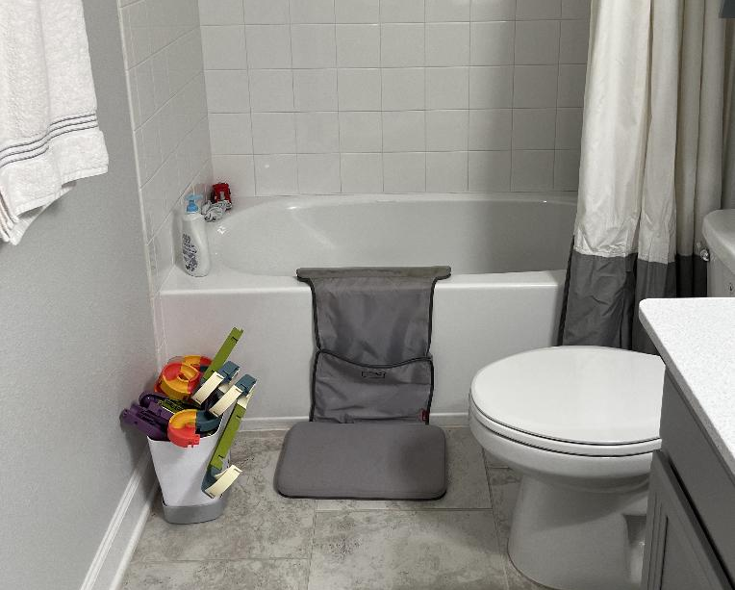
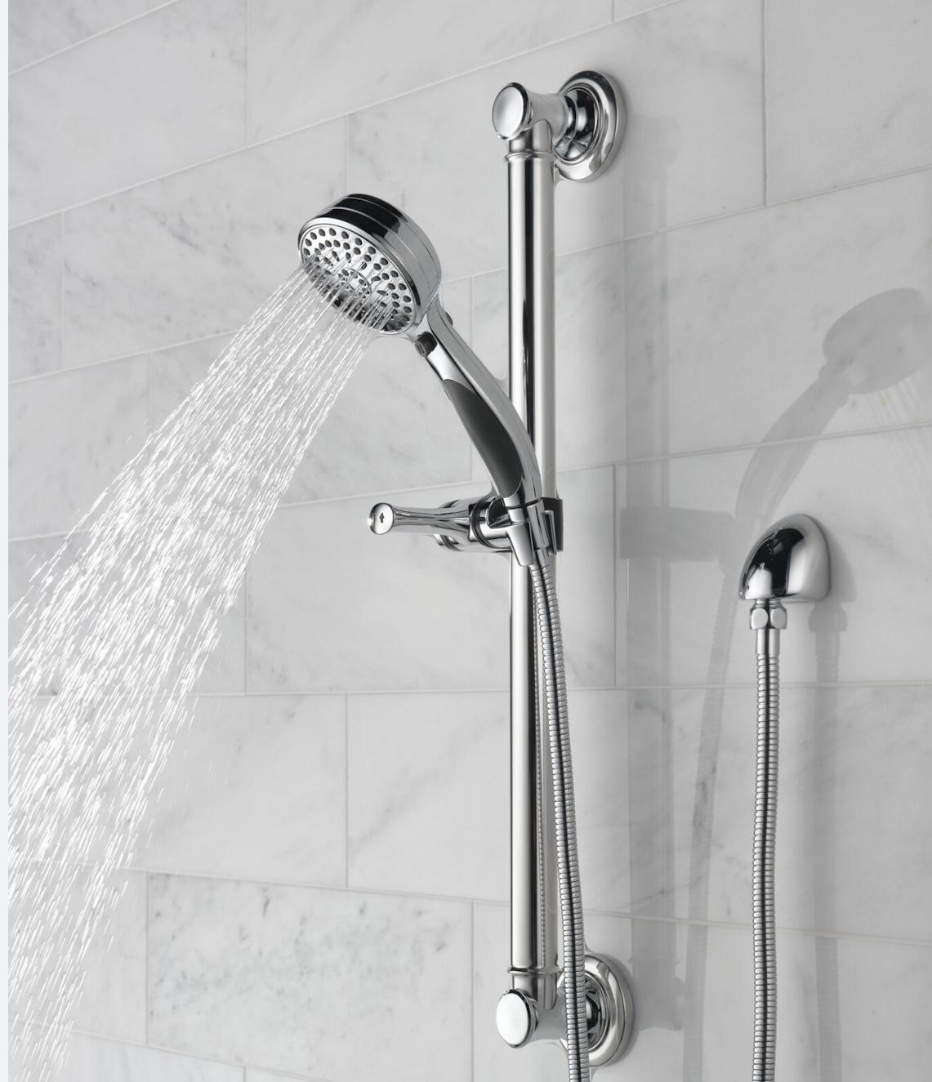
Bathroom Modifications Pictorial Overview
(Drive Medical, n.d.)
(CSI Hardware, n.d.)
(American Disability Association, 2020)
(Swing up, n.d.)
(Delta, n.d.)

Slide 8
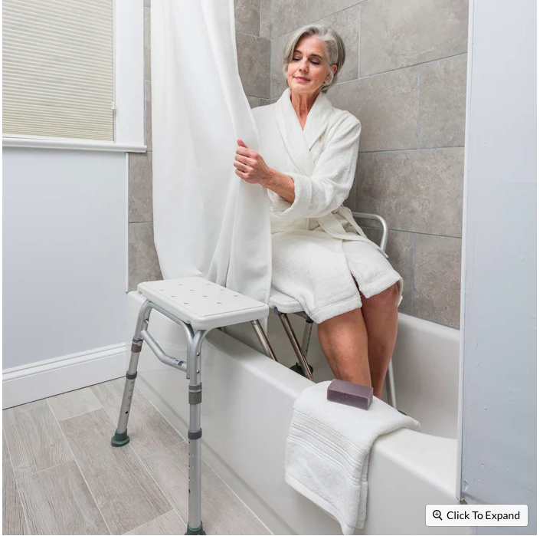
Bathroom Modification
Shower Chair
Description: Add a transfer bench with a shower chair to facilitate safe access to and from the shower. Include a curtain guard to prevent water damage.
Dimensions and Placement:
Seat-to-floor height: 18”
Overall depth: 16”
Seat width: 23”
Overall height: 28.5-33”
Width including outside legs: 33.5”
Specifications:
Weight: 12.7 lbs
Product material: Plastic, Aluminum, Steel
Weight capacity: 400 lbs
Available at: ProHeal Products (hyperlink attached)
Cost: ~$144.50 (before shipping and tax)
(Drive Medical, n.d.)
(Drive Medical, n.d.)

Slide 9
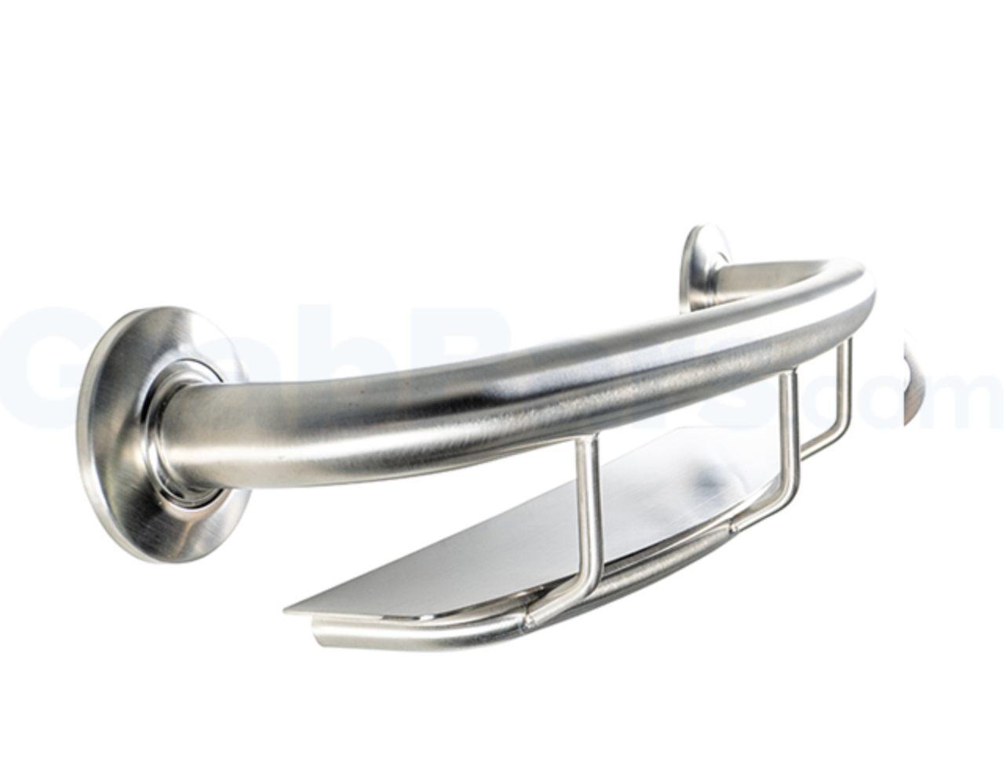
Bathroom Modification
Grab Bars
Description: Install grab bars for support during transfers and adjustments in the shower. Include a horizontal shower bar with shelf to ease accessibility to hygiene/shower products.
Entry Wall (Vertical) Grab Bar Dimensions and Placement:
Length: 24”
Position: Vertical, in line with the tub edge, on the same side as the spout/faucet
Specifications:
Material: Metal
Weight capacity: 300 pounds
Available at: Grab Bars (hyperlink attached)
Cost: ~$32.27 before shipping and tax
Side Wall (Horizontal) Grab Bar Dimensions:
Length: 36”
Position: Horizontal, at waist height or 36” from the floor
Specifications:
Material: Metal
Weight capacity: 300 pounds
Available at: Grab Bars (hyperlink attached)
Cost: ~$92.76 (before shipping and tax)
(Drive Medical, n.d.)
(CSI Hardware, n.d.)

Slide 10
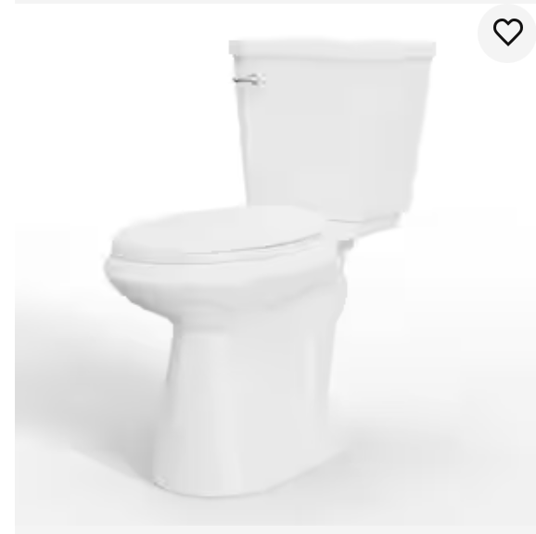
Bathroom Modification
ADA Compliant Toilet
Description: Install a toilet above the floor, in line with ADA recommendations, to ease transfer to and from the toilet.
Toilet Dimensions and Placement:
17-19” above the floor, in line with ADA recommendations
Specifications:
Weight capacity: 500 pounds
Material: Porcelain toilet; Plastic seat; Metal handle
Available at: Home Depot (hyperlink attached)
Cost: ~$279.00 (before shipping and tax)
(American Disability Association, 2020)
(American Disability Association, 2020)

Slide 11
Bathroom Modification
Toilet Swing-Up Grab Bar
Description: A swing-up grab bar (or flip-up bar) that can pivot upward when not in use to keep the bathroom area clear. It provides support during transitions to and from the toilet.
Dimensions and Placement:
30” length (11x3.25” wall mounting plate)
36” from the floor
Specifications:
Weight Capacity: 500 lbs
Material: Plastic handles
Available at: Home Depot and Grab Bars and EZ Mobility Solutions (hyperlinks attached)
Cost: ~98.08 for one Swing Bar (before shipping and tax)
(Lindbergh, M., 2020)
(Swing up, n.d.)

Slide 12
Bathroom Modification
Sliding Shower Head
Description: Install a hand shower with a slide bar for adjustable shower head height and better accessibility during showering.
Dimensions and Placement:
Length 27 inches
Width 3 inches
Specifications:
Weight Capacity: 500 lbs
Material: Metal handles and fixtures
Available at: Home Depot (hyperlink attached)
Cost: ~$67.98 (before shipping and tax)
(Delta, n.d.)

Slide 13
Bathroom Modification
Removal of Obstacles
Description: Remove the step stool, kneeling mat, and toy basket from the bathroom area to reduce tripping hazards. Store these items under the sink or within shelving.

Slide 14
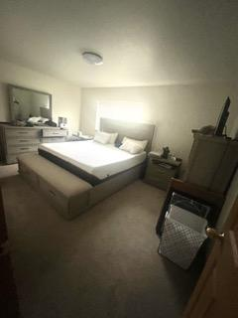
Bedroom

Slide 15
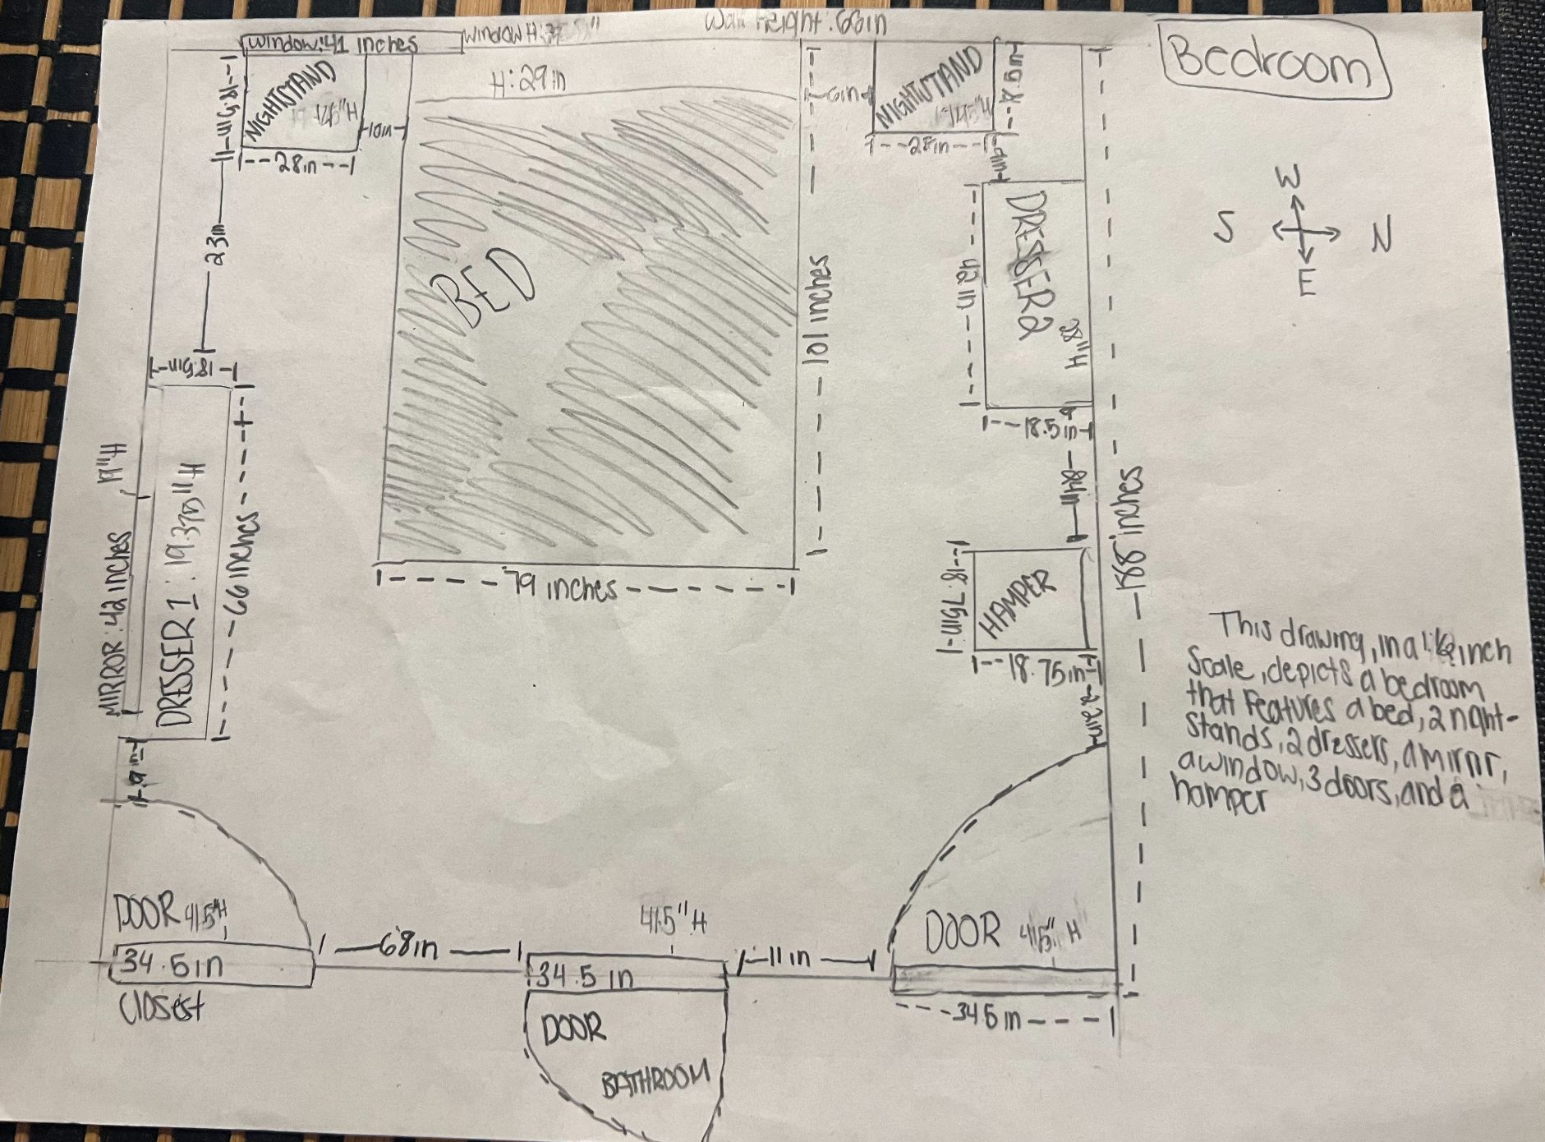
Bedroom: ½” Scale
This drawing, in a ½ inch scale, depicts a bedroom that features a bed, 2 nightstands, 2 dressers, a mirror, a window, 3 doors, and a hamper

Slide 16
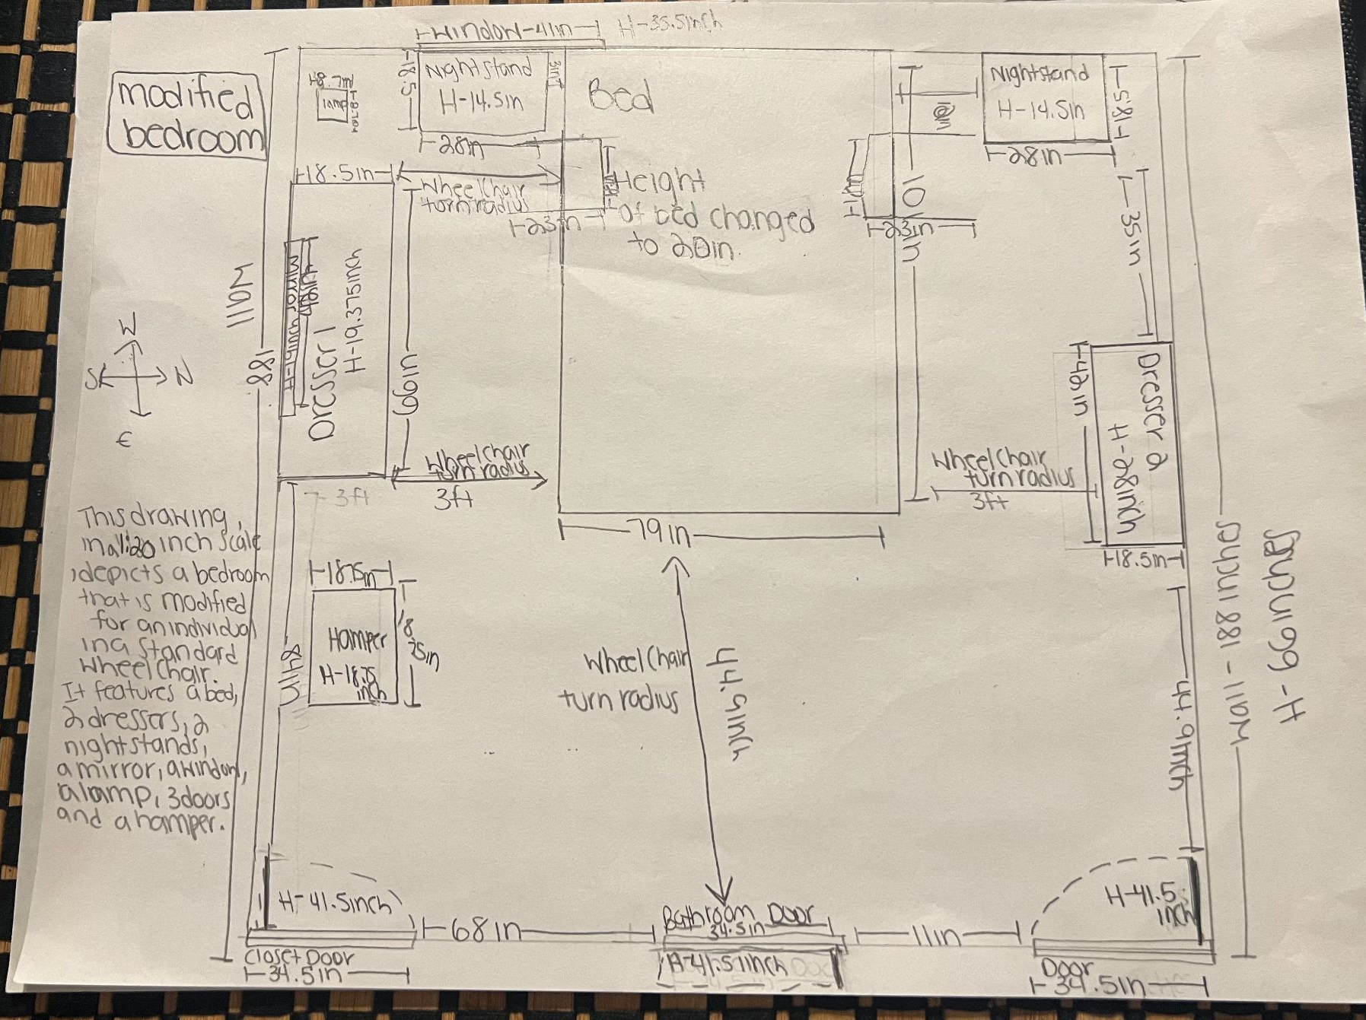
Bedroom: Modified ½” Scale
This drawing, in a 1:20 scale, depicts a bedroom that is modified for an individual in a stand wheelchair. It features a 20 inch bed, 2 dressers, 2 nightstands, a lamp, 3 doors, and a hamper.

Slide 17
Bedroom Modifications Overview
Storage Reorganization
Bed Rail Installation
Bed and Furniture Reconfiguration
Adaptive Lighting Solution
Relocate the hampers to the opposite side of the room to increase accessibility to the closet and dresser
Install a bed rail to assist with transfers between the bed and the wheelchair
Optimize the space to facilitate wheelchair access by adjusting the bed and dresser.
Introduce a remote-controlled light to enhance safety.

Slide 18
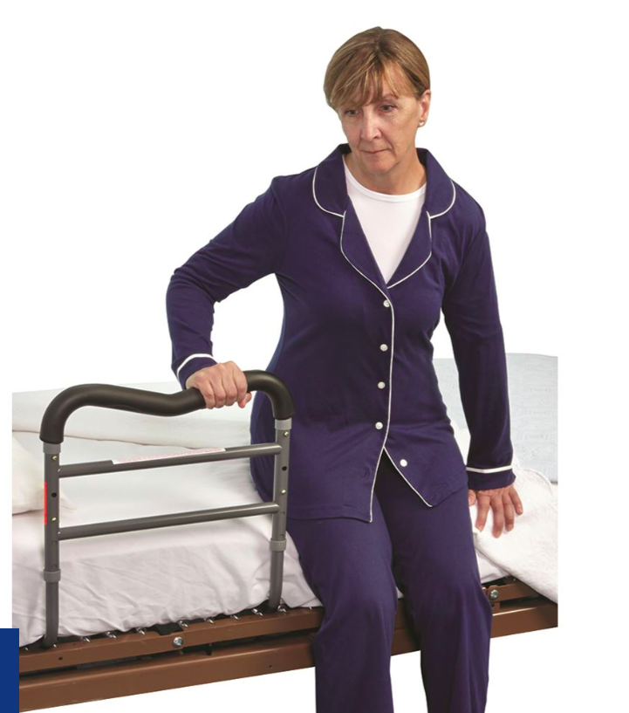
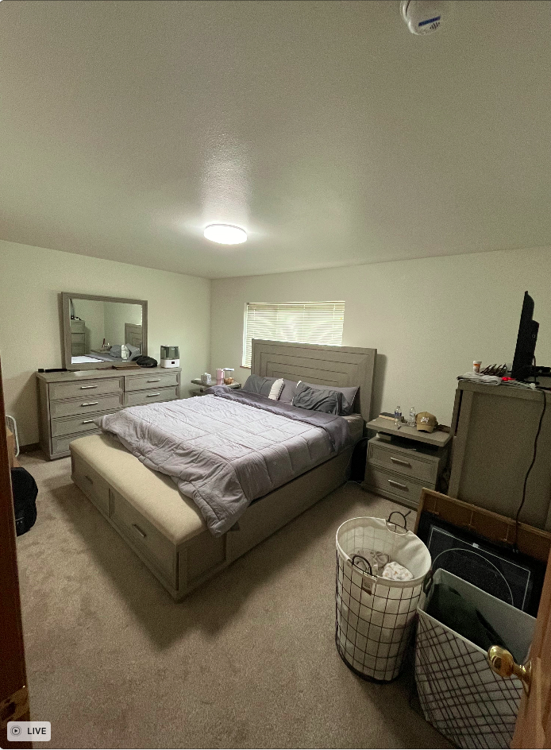
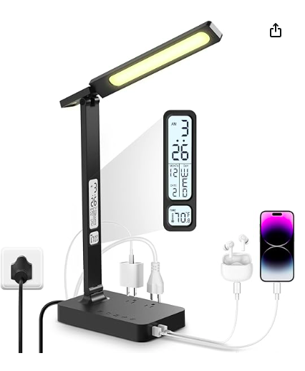
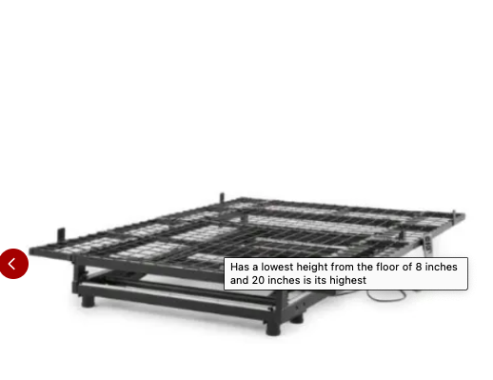
Bedroom Modifications Pictorial Overview
(Infiway, n.d.)
(AliRail, n.d.)
(Clapper, n.d.)
(EZ Out of Bed, n.d.)

Slide 19
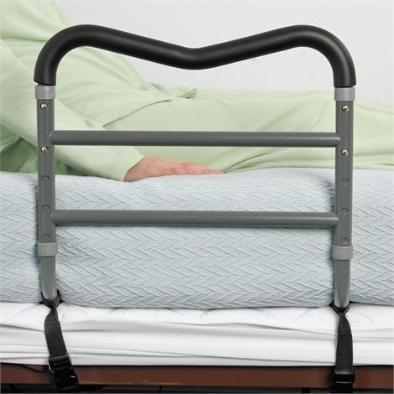
Bedroom Modification
Bed and Rail Installation
Description: Install a Bed Rail to assist with transfers from the bed to the wheelchair and vice versa. This addition is essential for safety and ease of movement.
Dimensions and Placement:
Width: 18 inches
Height: 22 inches
Base: 39 inches in width x 33 inches in length
Straps: 97.5 inches in length
Specifications:
Material: Steel
Weight: 5 lbs
Capacity: 300 lbs
Note: Tool-free assembly
Cost: ~$67.50 (before shipping and tax)
Available at: AliRail™ Bed Rail (hyperlink attached)
(AliRail, n.d.)
(AliRail, n.d.)

Slide 20
Bedroom Modification
Bed and Furniture Reconfiguration
Description: Moving the bed over to the right will add more room on the left side of the bed to transfer onto, this is also to ensure there is enough space to get the wheelchair between the dresser and the bed (Standard wheelchair is about 2.5 ft to ensure that the bed and dresser are both accessible; approximately 3 to 4 ft should be available). Moving the hampers to the other side of the room, closer to the closet to ensure there is enough room to access the other dresser.

Slide 21
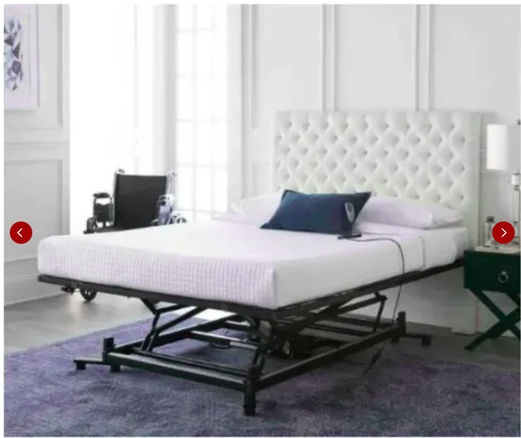
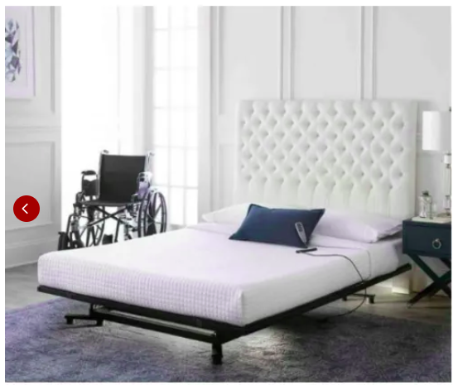
Bedroom Modification
Adjustable Bed Frame
Description: The bed is a little higher than a standard bed, which could cause difficulty when transferring. Include an adjustable bed frame that can lift up and lower down to facilitate easier transfers due to its ability to adjust height. This frame includes under-bed lighting and is controlled via a hand-held remote, making adjustments simple and safe.
Dimensions and Placement (Queen Size Frame):
Length: 80 inches
Width: 60 inches
Adjustments off the floor: 8 inches - 20 inches
Specifications:
Weight capacity: 450 lbs
Assembly time: Less than 15 minutes
Remote control operated
Material: Metal
Warranty: 10-Year Limited
Cost: ~$1180.00
Available at: EZ Out Bed at RehabMart (hyperlink attached)
(EZ Out of Bed, n.d.)

Slide 22
Bedroom Modification
Adaptive Lighting Solution
Description: Introduce a remote and sound activated (via clapping) controlled lamp. This adapted lamp will give the client the ability to access the light before he/she gets up, thus reducing the risk of falling.
Dimensions for Light:
Width: 5.12 inches
Height: 16.54 inches
Base (depth of base): 3.15 inches
Specifications for Light:
Material: Plastic
Color: Black
Features: Remote Controlled, Dimmable LED, USB Charging, Clock, Alarm, Date, Temperature, Timer
Operating Voltage: 120V
Cost: ~$33.99 (before shipping and tax)
Available at: Amazon (hyperlink attached)
(Infiway, n.d.)

Slide 23
Bedroom Modification
Adaptive Lighting Solution
(Continued)
Dimensions for Sound Activated Device:
Width: 6.3 inches
Length: 2.5 inches
Height: 8 inches
Specifications for Sound Activated Device:
Connector-Type: Plug-in (120V wall plug)
Material: Plastic
Cost: ~$19.95 (before shipping and tax)
Available at: Amazon (hyperlink attached)
(Clapper, n.d.)

Slide 24
Overall Cost Estimate in the
State of North Carolina (All cost figures/estimates are approximate)
Product | Cost | Sales Tax (7.5%, NC) | Shipping | Total
Lamp | $33.99 | $2.55 | $0.00 | $36.54
Clapper(R) | $19.95 | $1.50 | $0.00 | $21.45
Bed Frame | $1,800.00 | $88.50 | $100.00 | $1,368.50
Bed Rail | $67.50 | $5.06 | $15.00 | $87.56
Shower Head | $67.98 | $5.10 | $0.00 | $73.08
Swing-Up Grab Bar | $98.08 x 2 = $196.16 | $14.71 | $0.00 | $210.87
Toilet | $279.00 | $20.93 | $0.00 | $299.93
Vertical Grab Bar | $32.27 | $2.42 | $10.00 | $44.69
Horizontal Grab Bar | $92.76 | $6.96 | $10.00 | $109.72
Shower Chair | $144.50 | $10.84 | $20.00 | $175.34
 |  |  | Grand Total | $2,427.68

Slide 25
Handy Helpers Service
No-Cost labor service
Funded by the Orange County Department of Housing
Provides home safety modifications to support accessibility
Program coordinator: (919) 245-4245
Requirements for eligible participants:
Homeowner or renter in Orange County, North Carolina
A disability diagnosis and a formal occupational therapy assessment
Income below $56, 650 (single) or $64,750.00 (couples)
(Orange County Department Services, 2024)
(Orange County Department Services, 2024)

Slide 26
References
AliRail. (n.d.). AliRail bed rail [Photograph]. AliMed. https://www.alimed.com/alirail-bed-rail.html
AliRail. (n.d.). AliRail bed rail [Photograph]. AliMed. https://www.alimed.com/alirail-bed-rail.html
American Disability Association. (2020). Water closet accessibility standards [Image]. reThink. Access. https://www.rethinkaccess.com/articles/tag/Water+Closet
Clapper. (n.d). Clapper boxed product [Photograph]. Amazon. https://www.amazon.com/Clapper-Activated-Detection-Appliances-Technology/dp/B0000CGKLR
CSI Bathware. (n.d.). Shower shelf grab bar [Photograph]. Grab Bars. https://www.grabbars.com/product/shower-shelf-grab-bar/
Delta. (n.d.). Decorative grab bar/slide bar [Photograph]. Delta. https://www.deltafaucet.com/bathroom/product/51900.html
Drive Medical. (n.d.). Shower Chair [Photograph]. Pro Heal Products. https://prohealproducts.com/products/splash-defense-transfer-bench-with-curtain-guard-protection?variant=42706853920941&utm_source=google&utm_medium=cpc&adpos=&scid=scplp42706853920941&sc_intid=42706853920941&gad_source=1&gclid=Cj0KCQjw6uWyBhD1ARIsAIMcADr1R0VKGPiIhlcdK7G8dzohjyf3sLPzz8x9KLjgA4zJ98KN0vtEehsaAhEpEALw_wcB

Slide 27
References
EZ Out of Bed. (n.d). Product photos [Photograph]. RehabMart. https://www.rehabmart.com/product/easy-out-bed-hi-lo-adjustable-bed-frame-51540.html?srsltid=AfmBOoq7R8nhhhi2u9rS97hXiIChQVSF8UAB3-legp2GCrppGa9AvH_z-bc
Infiway. (n.d.). Desk lamp [Photograph]. Amazon. https://www.amazon.com/dp/B0CWSX37M4
Lindbergh, M. (2022). Flip up grab bar [Photograph]. Toilet Talk. https://toilettalk.me/grab-bar-guide
Swing Up Grab Bars. (n.d.) Flip up grab bar [Photograph]. Grab Bars. https://www.grabbars.com/product/swing-up-grab-bar/
Orange County Department of Health and Human Services, North Carolina. (2024). Handy helpers [Photograph]. https://www.orangecountync.gov/2374/Handy-Helpers
Orange County Department of Health and Human Services, North Carolina. (2024). Handy helpers. Retrieved June 10, 2024, from https://www.orangecountync.gov/2374/Handy-Helpers

